Slide 1
Comparing Compute Options for Microservices in AWS
Arun Gupta
Principal Technologist, @arungupta Amazon Web Services

Slide 2
A Typical Application with Microservices
Client
Webapp
Webapp
Webapp
Greeting
Name
Greeting
Name
Greeting
Name

Slide 3
Microservices and Containers
Language-agnostic
Scaling
Upgrading
Service discovery

Slide 4




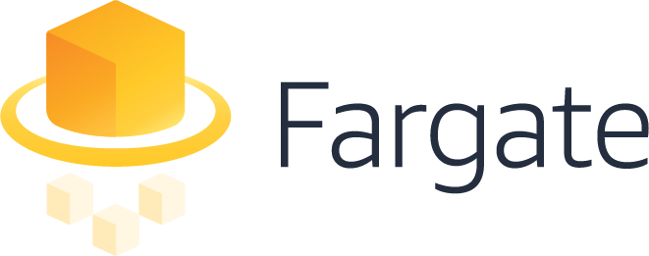



Amazon Container Services
(coming soon)

Slide 5
Fargate or ECS?

Slide 6
Running Containers with ECS
Notes:
So let’s talk about how to use FARGATE with ECS. You want to think about Fargate as a technology and not a different service per se when using it with ECS. I.e. no new APIs to learn.
[CLICK]
Here’s a screenshot of ECS when you define an application (called a Task Definition), you are presented with an option to select compatibilities with a launch type – Fargate is just a launch type. If you want to run your containers on the EC2 Instances registered with your ECS cluster, that is the EC2 Launchtype.
====================
For example a runtask command has a new launchtype: ecs run-task --launch-type FARGATE --cluster fargate-test --task-definition nginx --network-configuration "awsvpcConfiguration={subnets=[subnet-b563fcd3]}"

Slide 7


Amazon ECS CLUSTER
Subnet 1
Subnet 2
Subnet 3
172.31.1.0/24
172.31.2.0/24
172.31.3.0/24
Web
FARGATE
Shopping Cart
ECS Instance
ECS Instance
ECS Instance
ECS Instance
ECS Instance
ECS Instance
Notifications
EC2
Availability Zone #1
Availability Zone #2
Availability Zone #3
Notes:
Fargate clusters are heterogeneous.
Say you have different requirements where the notifications app team would like to be able to move to Fargate but has a different timeline planned to do so but are ready to use Fargate for your Shopping cart and web apps.
[CLICK]
As you notice, you can run the Web and shopping cart apps as ECS services with launch type Fargate and you only see your tasks across the various subnets and AZs. You can continue to run Shopping Cart and Notifications apps as EC2 Launch Types within the same cluster as the Fargate powered Web app and network boundaries thereby applying uniform set of policies in terms of IAM permissions as well as network access rules.
Notice, how the containers are spread across different subnets across AZ. This gives high resiliency and fault tolerance to your microservices.

Slide 8
Deploying Microservices
using
AWS Fargate

Slide 9

ELASTIC CONTAINER SERVICE FOR KUBERNETES
Notes:
We listened, and that’s why we’ve built Elastic Container Service for Kubernetes- or EKS.
We know how important a Kubernetes service is to our customers. So we didn't build Amazon EKS haphazardly. An excellent way to communicate how we took your feedback and synthesized it into a service is by taking a look at the core tenets for EKS. These tenets anchored our decision-making for how Amazon EKS should work.

Slide 10

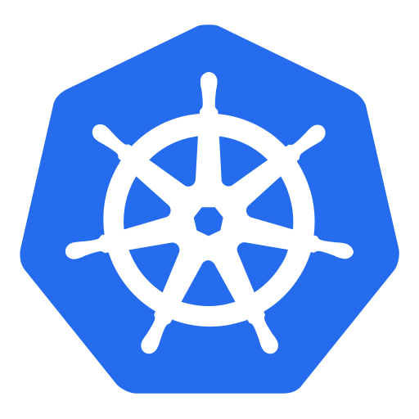

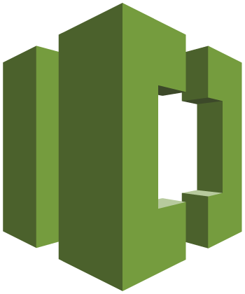
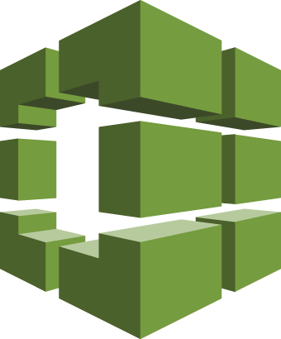
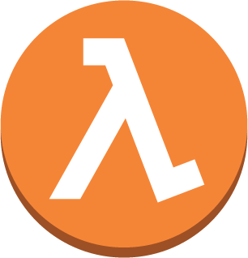

AWS CodePipeline – CI/CD with Kubernetes
6
1
Developers continuously integrate changes into a main branch hosted within a repo
Amazon ECR
2
Triggers an execution of the pipeline when a new version is found, builds a new image with build ID
3
5
3
Pushes the newly built image tagged with build ID to ECR repo
4
Invokes a Lambda function to trigger application deployment
1
2
4
5
Leverages Kubernetes Python SDK to update a deployment
Developer
AWS CodeCommit
AWS CodeBuild
AWS Lambda
6
Fetches new container image and performs a rolling update of deployment
AWS CodePipeline

Slide 11
Deployment Pipeline
for
Microservices using Kubernetes

Slide 12
















Spectrum of Serverless at AWS
“On EC2”
Managed
Serverless
Amazon EMR
Amazon ES
AWS
Lambda
Amazon Cognito
Amazon Kinesis
Amazon EC2
Amazon S3
Amazon DynamoDB
Amazon SQS
Amazon ElastiCache
Amazon Redshift
Microsoft SQL Server
Amazon RDS
Amazon API Gateway
Amazon CloudWatch
AWS IoT
Notes:
Provide context on Region & AZ – 16 regions & 52 AZ
To make HA, On EC2, you need to deploy across different AZ. On Managed, there is an option for multi-AZ. In Serverless, everything (HA & Fault tolerance) is taken care of for you.
First service was S3 and SQS – Serverless services. Lambda was added as Compute to S3 because of customer feedback. And then we added other sources to Lambda.
Provides a wide spectrum of services from Chatbot, IT automation, web application, Alexa and many others. We’ll look at a few of those today.

Slide 13
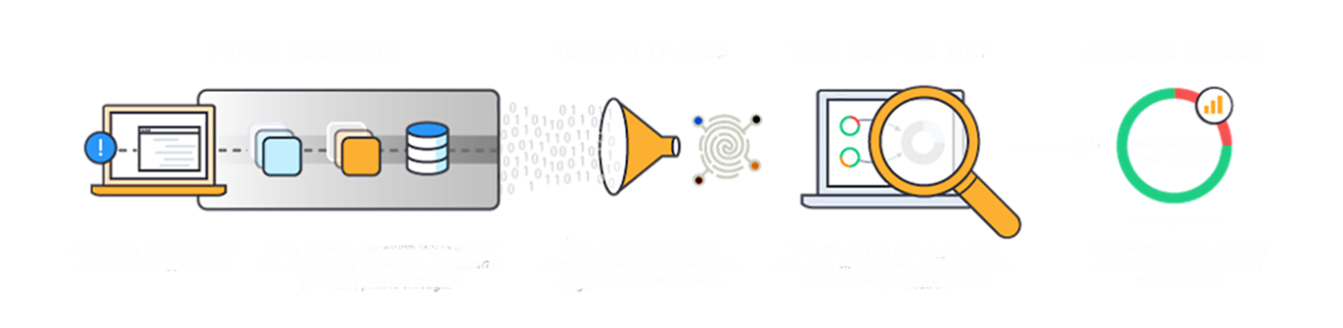
X-Ray Service
Notes:
X-Ray helps you with tracing requests, record the traces in the X-Ray service, view service map of your distributed application in the X-Ray console and analyze specific issues that are affecting your application within a specific time frame.

Slide 14
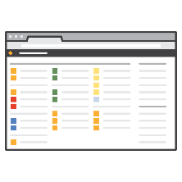










X-Ray Workflow
X-Ray Console
DevOps Team
HTTPS
Localhost
UDP
Localhost
UDP
HTTPS
HTTPS
App & X-Ray
SDK
App & X-Ray
SDK
X-Ray API
AWS
Credentials
X-Ray
Daemon
X-Ray
Daemon
EC2 Role
On-prem Server
EC2 Instance/Containers/Lambda
Notes:
The X-Ray daemon listens on UDP. It receives data from the SDK over UDP and acts as a local buffer. Data is flushed to the backend every second or when the local buffer fills. Daemon available for Amazon Linux AMI, RHEL, Ubuntu, OS X, and Windows.
Daemon talks to the X-Ray API/service over HTTPS.
You can use X-Ray on your on-prem servers by running the X-Ray daemon as well.
You can then view and analyze performance of your distributed application in the X-Ray console.

Slide 15
Monitoring Microservices
with
AWS X-Ray and AWS Lambda

Slide 16
Serverless or Containers>
It depends!

Slide 17
Serverless or Containers?
Serverless
Containers
Always managed (less operational overhead)
Mostly focused on the app
Short-lived/Event-driven architecture
300 ms execution time
50 MB deployment package
Language choices
Visual orchestration using AWS Step
Managed or Unmanaged
Long-lived
Multiple choices: ECS, Fargate, Kubernetes, …
Unlimited languages
No resource restrictions*
Community-driven innovation

Slide 18
github.com/ aws-samples/ aws-microservices-deploy-options

Slide 19
Thank you!

